Slide 1
Copy-MOVE IMAGE Forgery Detection
By
Sandipan Roy
Supervised by Prof. Kaushik Roy
Department of Computer Science
West Bengal State University

Slide 2
Contents
Introduction
Motivation for Forgery Detection
Review of Privious Works
Problems
Datasets
Proposed Approch
Result and Evolution
Feture Work
Referances
2

Slide 3
Introduction
What is Image Forgery?
Image forgery means manipulation of digital image to conceal meaningful information of the image.
What is Copy-Move Forgery?
Copy-Move forgery is a type of image forgery in which a portion of the digital image is copied from one place and pasted somewhere in that image.

Slide 4
Introduction(Cont.)
Why we need Copy-Paste Forgery Detection?
Image forgery detection is one of important activities of digital forensics. Forging an image has become very easy and visually confusing with the real one. One of the techniques most commonly used is the Copy-Move forgery which proceeds by copying a part of an image and pasting it into the same image, in order to maliciously hide an object or a region.

Slide 5
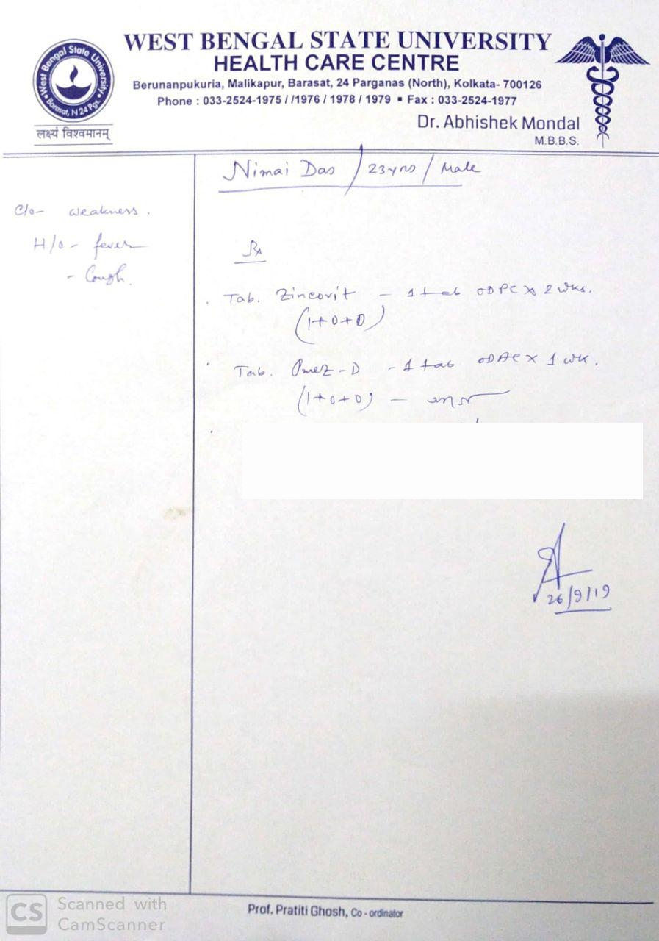
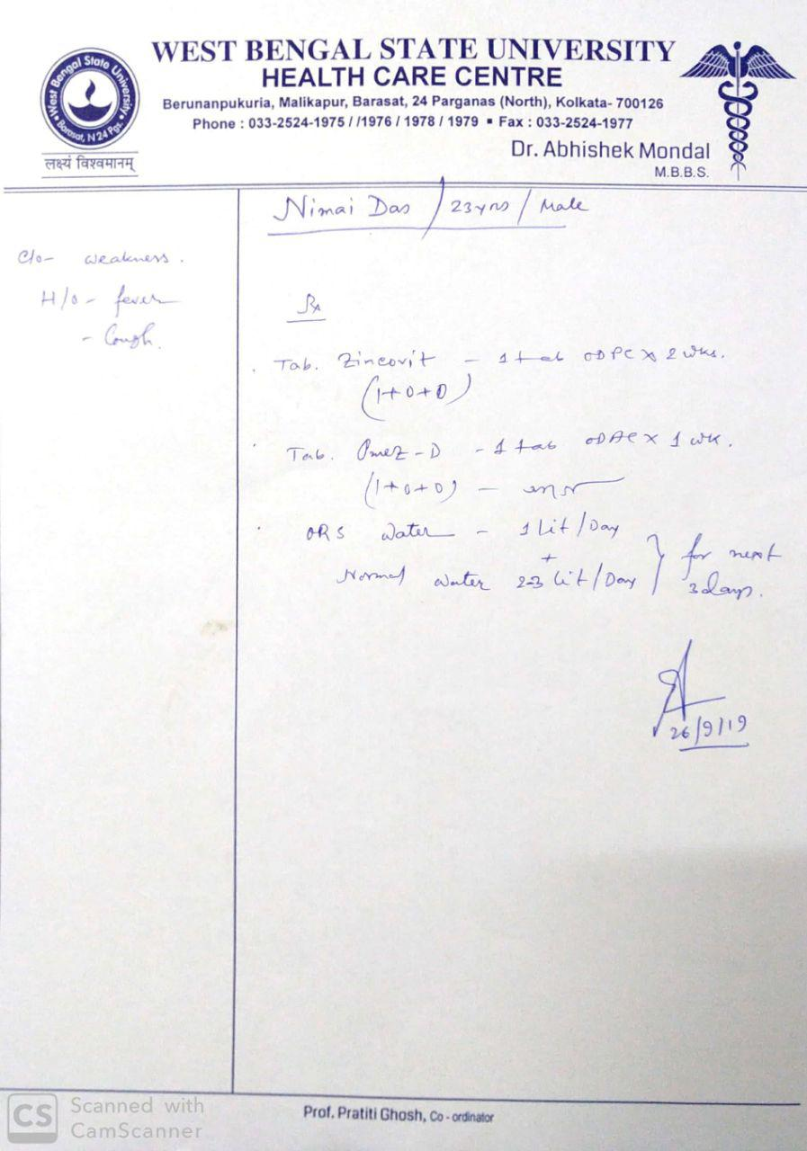
Reason for Forgery Detection
Copyright Symbol
Fake Face
Fake Signature
Fake News Image
Fake Art
Fake Medical Report
Fake Documents

Slide 6
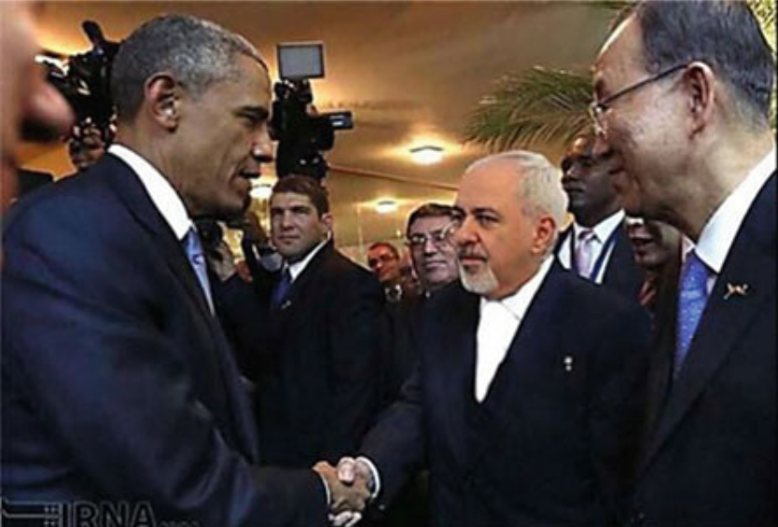
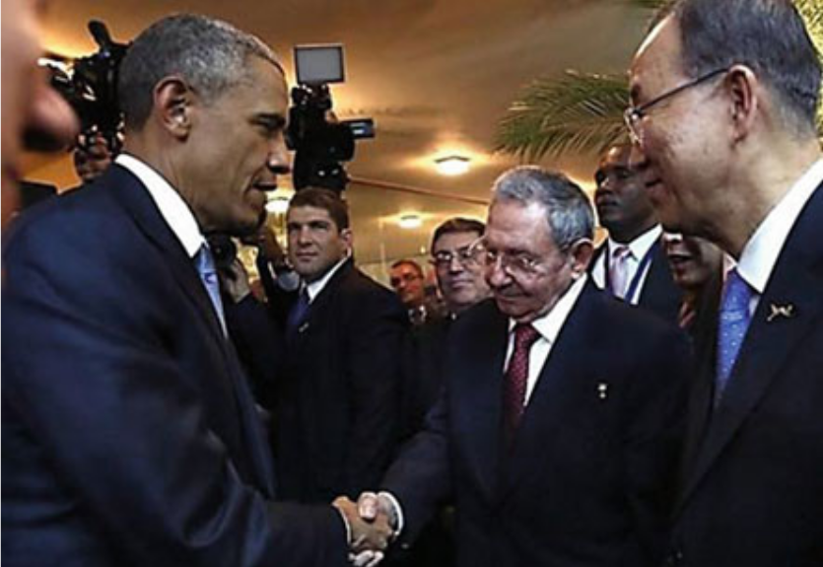
Reason for Forgery Detection
I think this is Original.
My Friends think this is Original.

Slide 7
Forgery Detection Mechanisms
Can be Classified into Two Types
  Active Methods
  Passive Methods
Active Methods
Hidden Information inside the Digital Image.
Done at the time of Data Acquisition or before disseminated to the public.
Passive Methods
Use traces left by the processing steps in different phases of acquisition
They work by analyzing the binary information of digital image in order to detect forgery traces, if any.
Now We can see some Passive Methods Proposed on Research Papers.

Slide 8
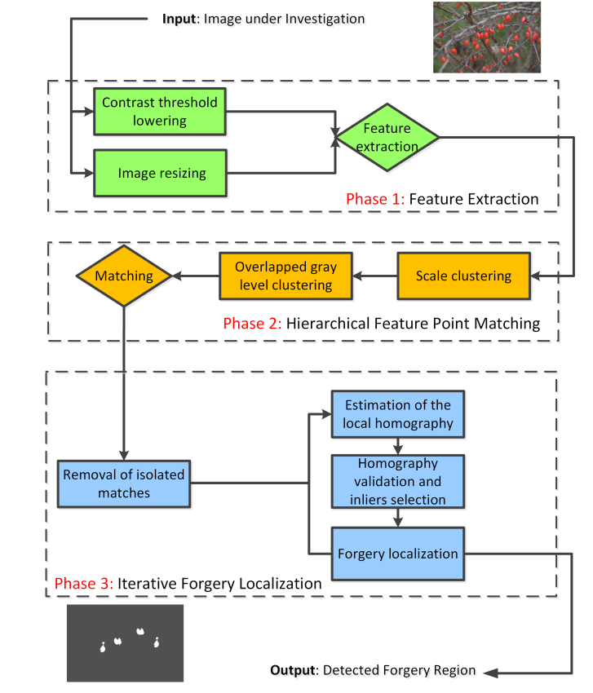
Limitations:
They got the forged points and very low false points but not getting the popper object.
Literature Review 1
Hierarchical Feature Point Matching:

Slide 9
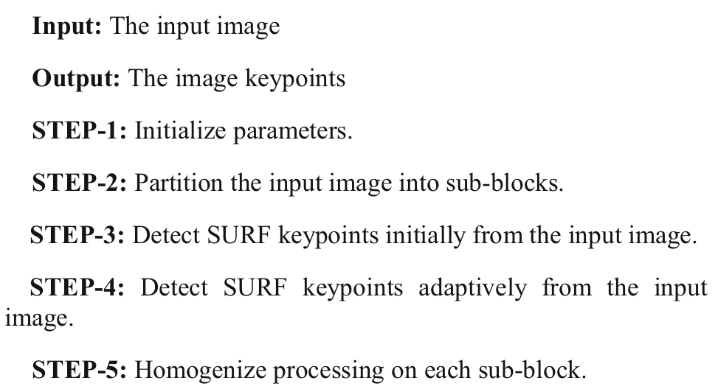
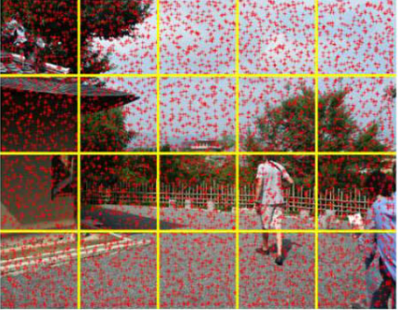
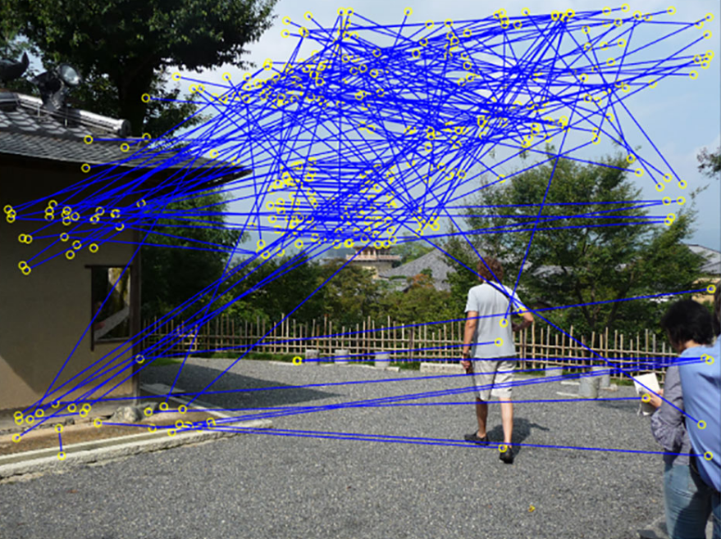
Limitations:
With very high computational power they are not getting the popper object.
Literature Review 2
Adaptive Keypoints Extraction and Matching:

Slide 10
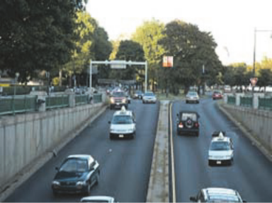
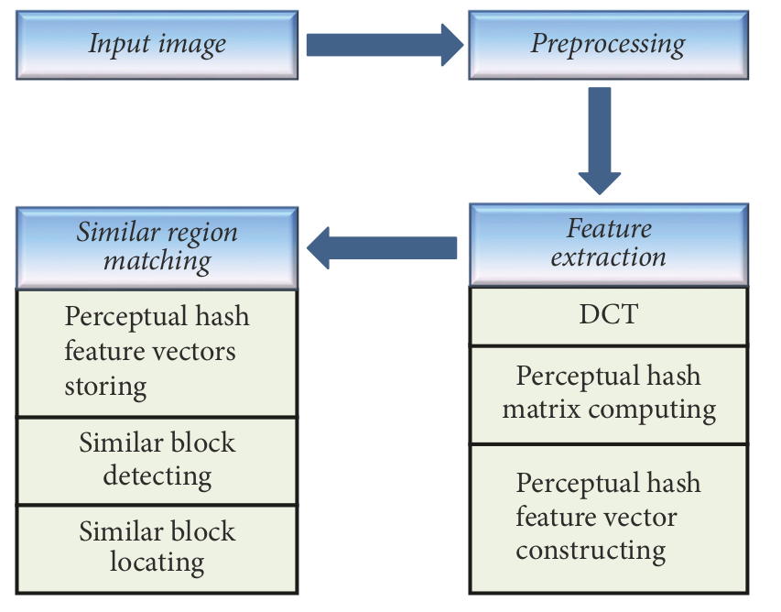

Limitations:
They get low accuracy in small copy-move regions.
Literature Review 3
Perceptual Hashing-Based:

Slide 11
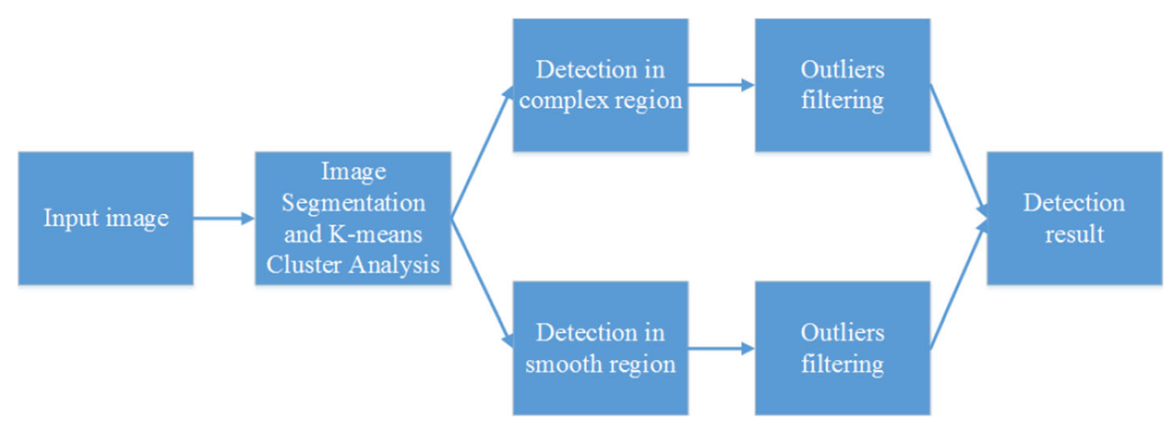
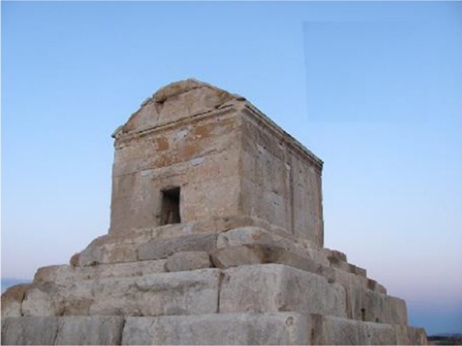
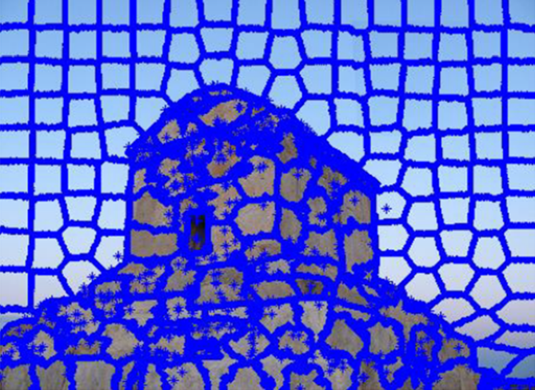
Limitations:
They can not detect which block or part is original and which is not.
Literature Review 4
Pixel segmentation and K-means Clustering:

Slide 12
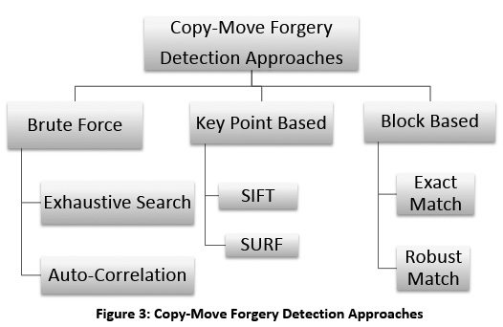
SUMMARY OF Literature Review

Slide 13
PROBLEMS
Lack of Labeled Samples and Certainty in Ground Truth
Getting Bad Prediction
Noise & False Positive
Wrong Assumptions
Imbalanced Data Sets

Slide 14
Available Datasets
NO | Dataset | Forged Region | Image Size (in pixels) | No. of Images
1 | CASIA 2.0 | Single | 384 × 256 | 700
2 | CVIP Group | Single | 1000 x 700 | 50
3 | CoMoFoD_v2 | Single | 512 x 512 | 3000
4 | CMFDdb-grip | Single | 1080 x 786 | 80
5 | Image Manipulation Dataset | Single | 3264 × 2448 | 48
6 | MICC-F220 | Single | 2048 x 1536 | 220
7 | MICC-F8 | Multi | 2048 x 1536 | 8
8 | COVERAGE | Single+Multi | Various Size | 100

Slide 15
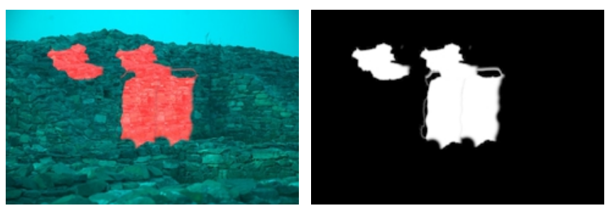
Available Dataset(Cont.)
Image Manipulation Dataset:
This dataset consist 48 forged images along with their original image and ground-truth, each image of size 3264 × 2448 pixels.

Slide 16
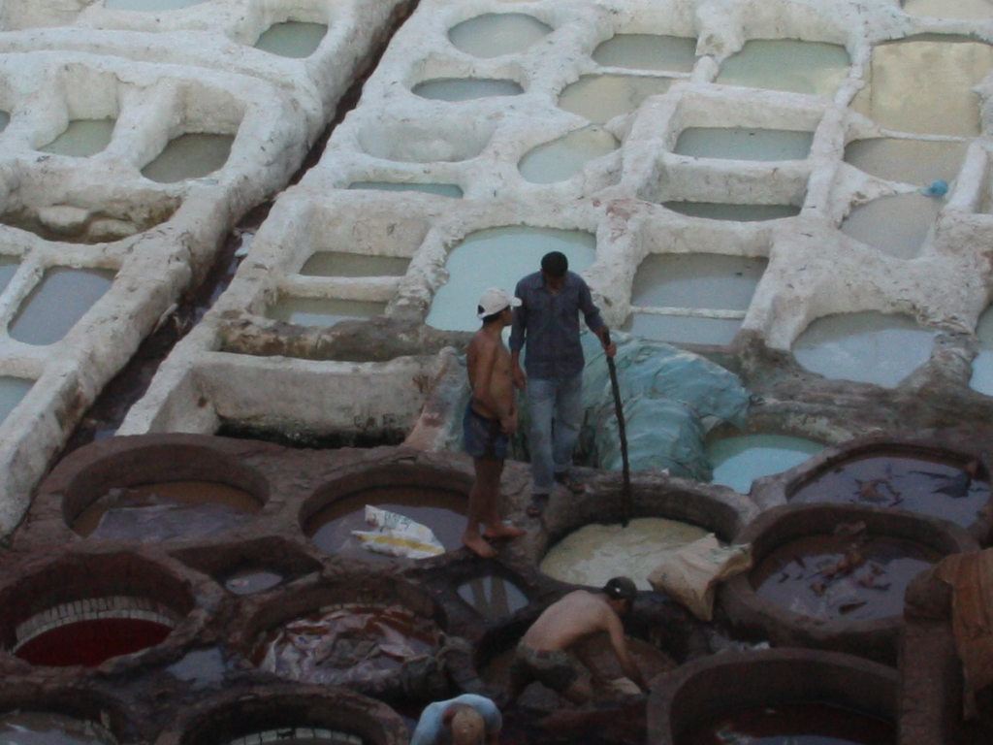
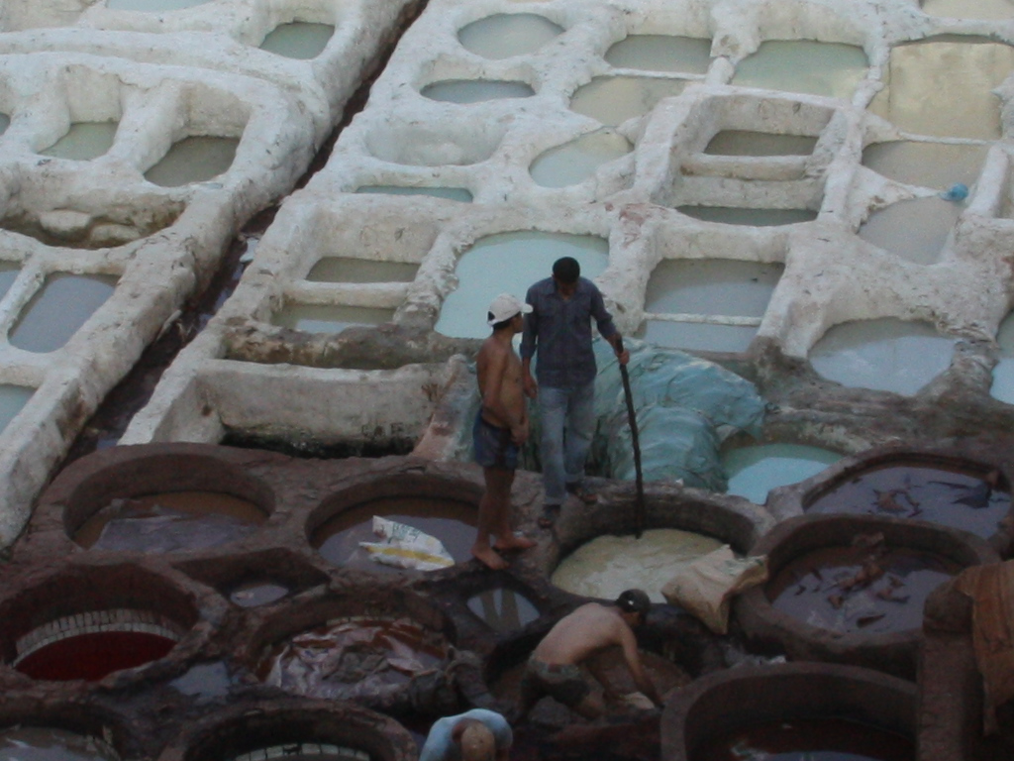
Available Dataset(Cont.)
CMFDdb-grip:
This dataset consist 80 forged images along with their original image and ground-truth, each image of size 1080 x 786 pixels.

Slide 17
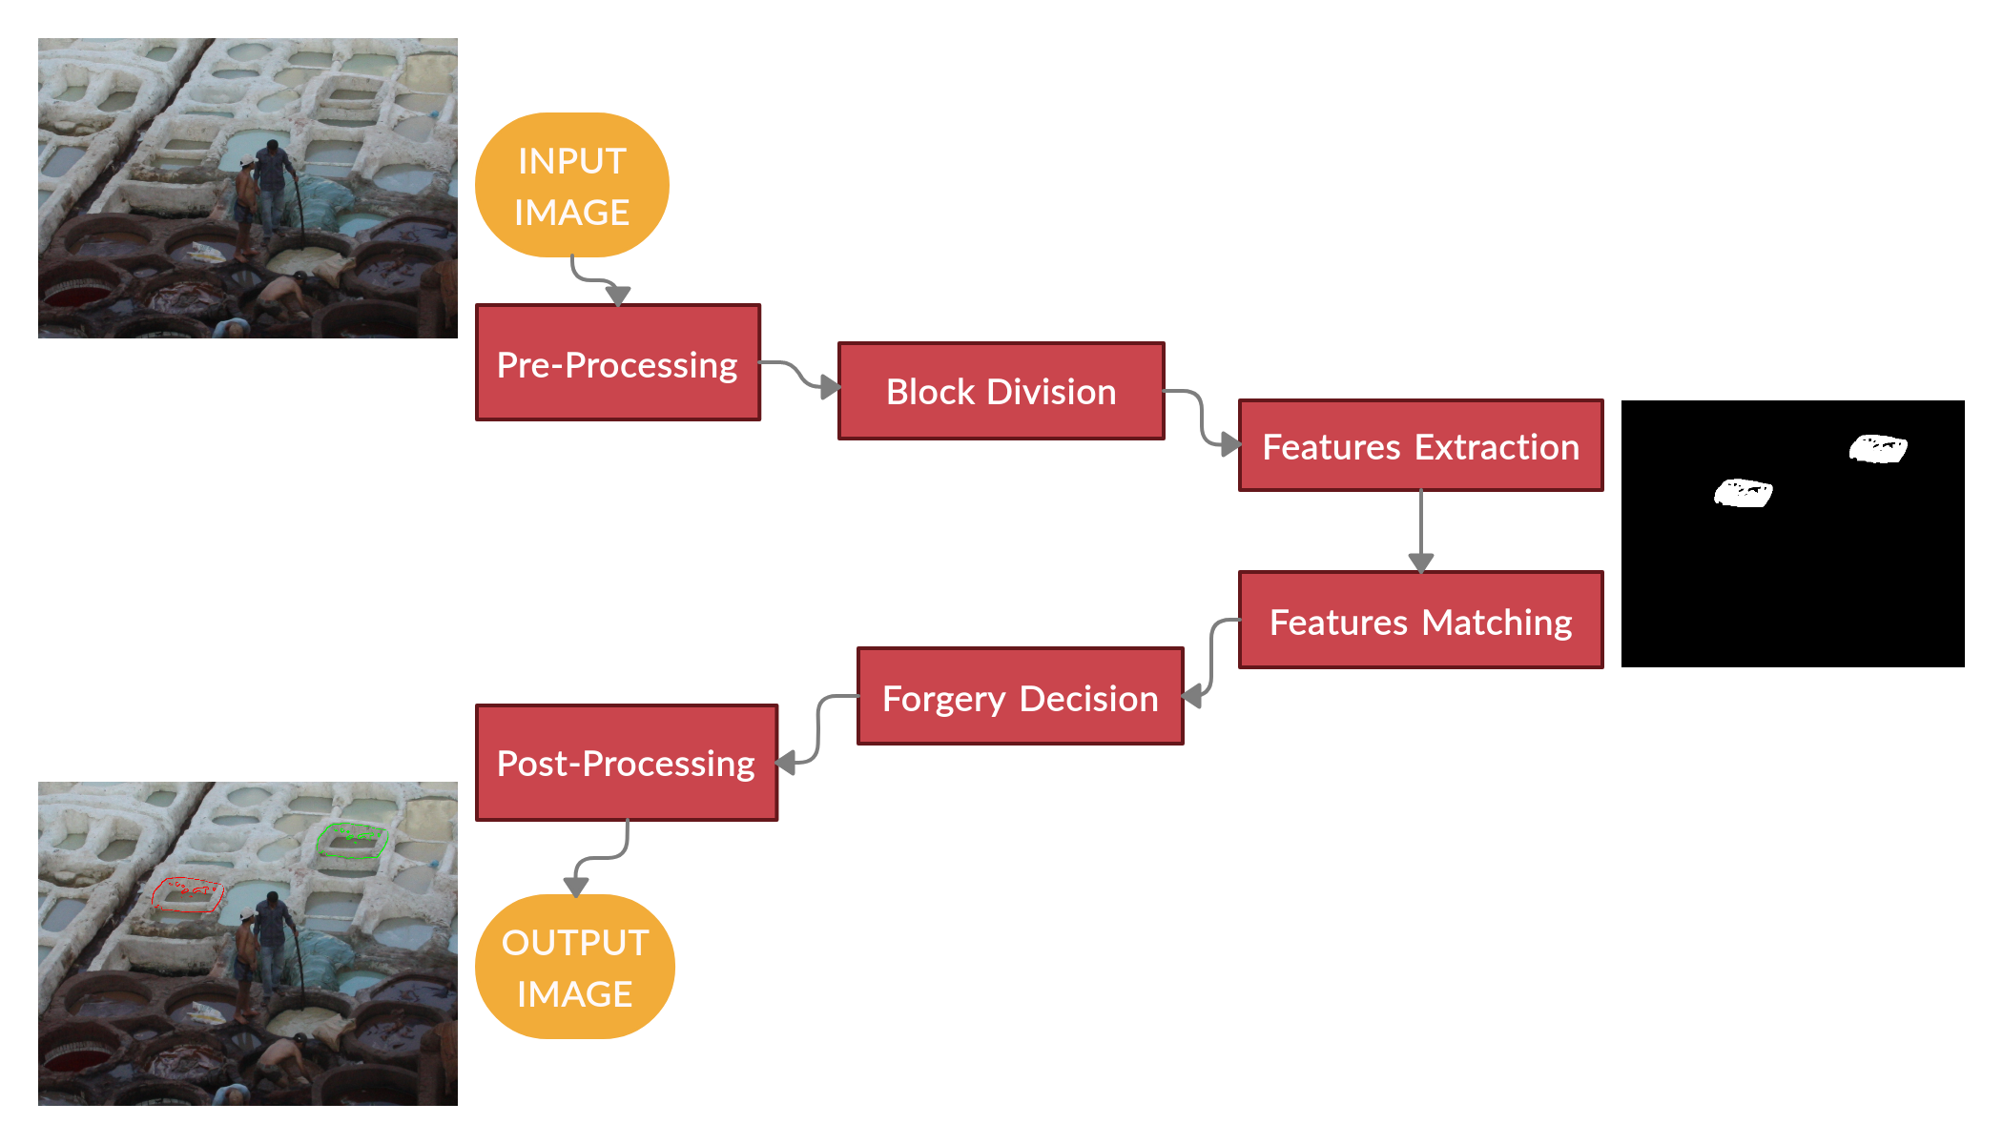
Proposed Approch

Slide 18
Proposed Approch(Cont.)
Pre-Processing
RGB to Gray/Binary/Padding(optional)
divided into NxN Blocks.
Sort the block index by its greater value,
Looks like, [8000[[1,2,3],....,[64th]]].....
[0[[1,2,3],....,[64th]]]
Detecting Forge Region by Brute-Force Block by Matcher.
Plot our matched index as same possition of input image to a blank image.
Block Division
Features Extraction
Features Matching
&
Forgery Decision
Post-Processing

Slide 19

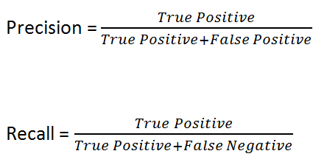

Results & Evaluation
Dataset in Use:
1.CMFDdb_grip
2.Image Manipulation Dataset
3.CVIP Group
4.MICC-F8
Used Evaluation Formula:

Slide 20
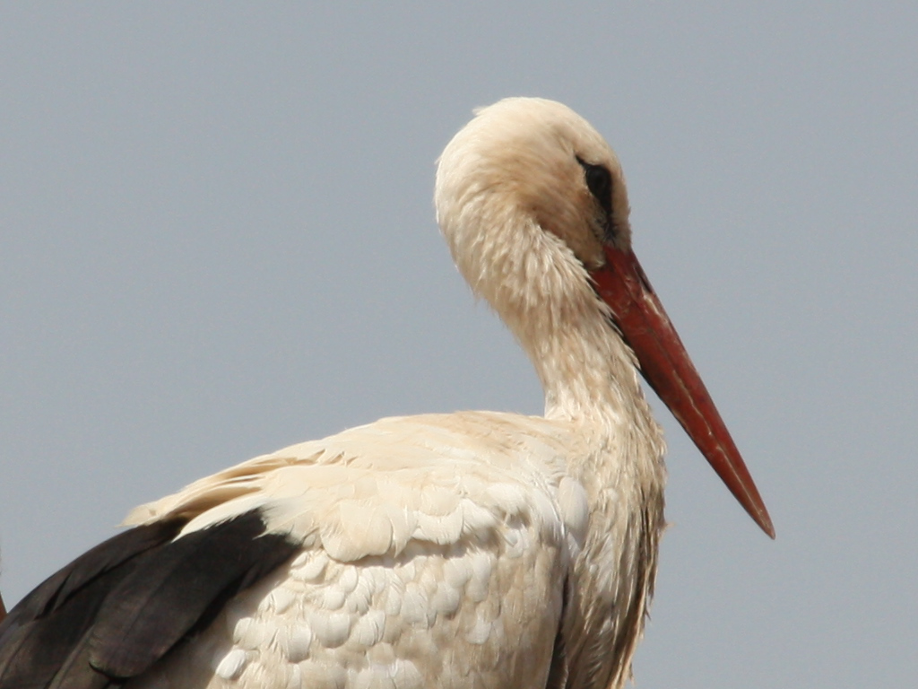
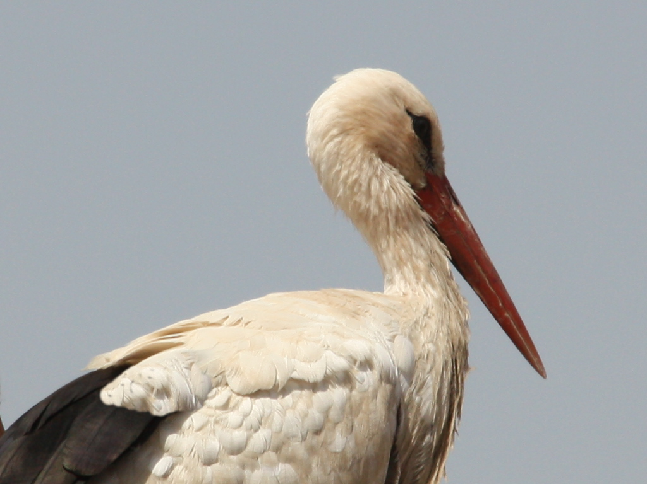


Examples
Original
Forged
Groud Truth
Our Result

Slide 21
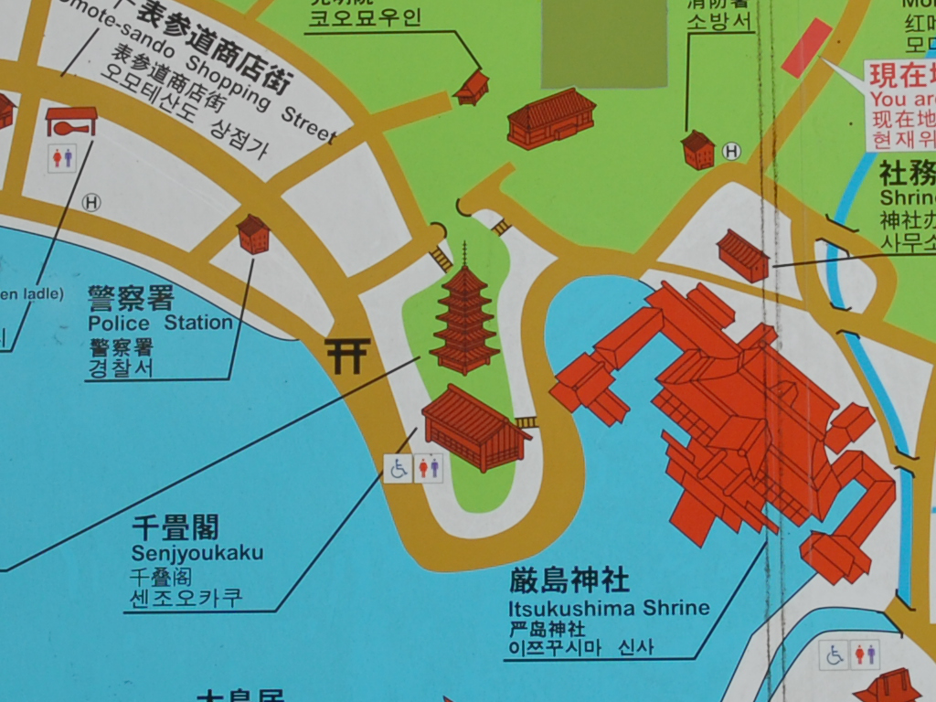
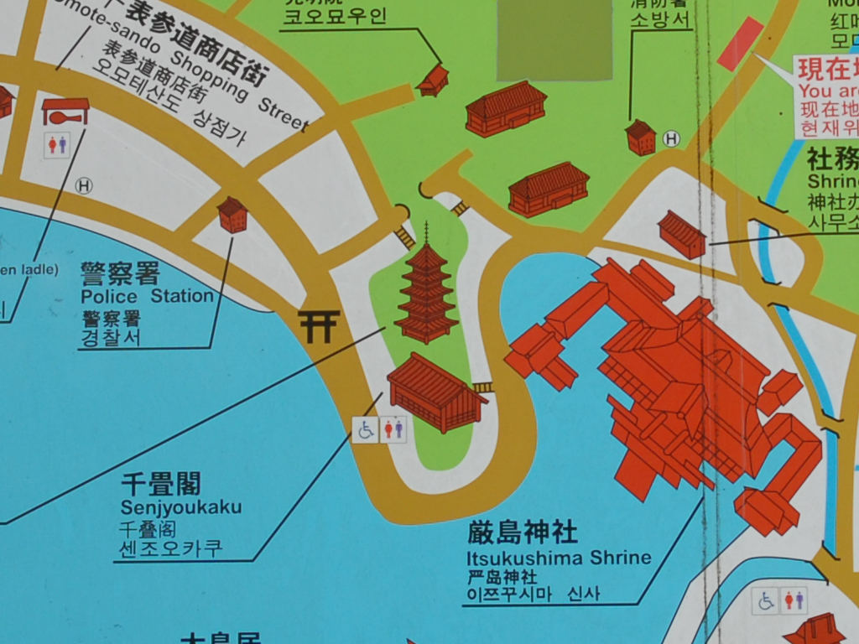


Examples(Cont.)
Original
Forged
Groud Truth
Our Result

Slide 22
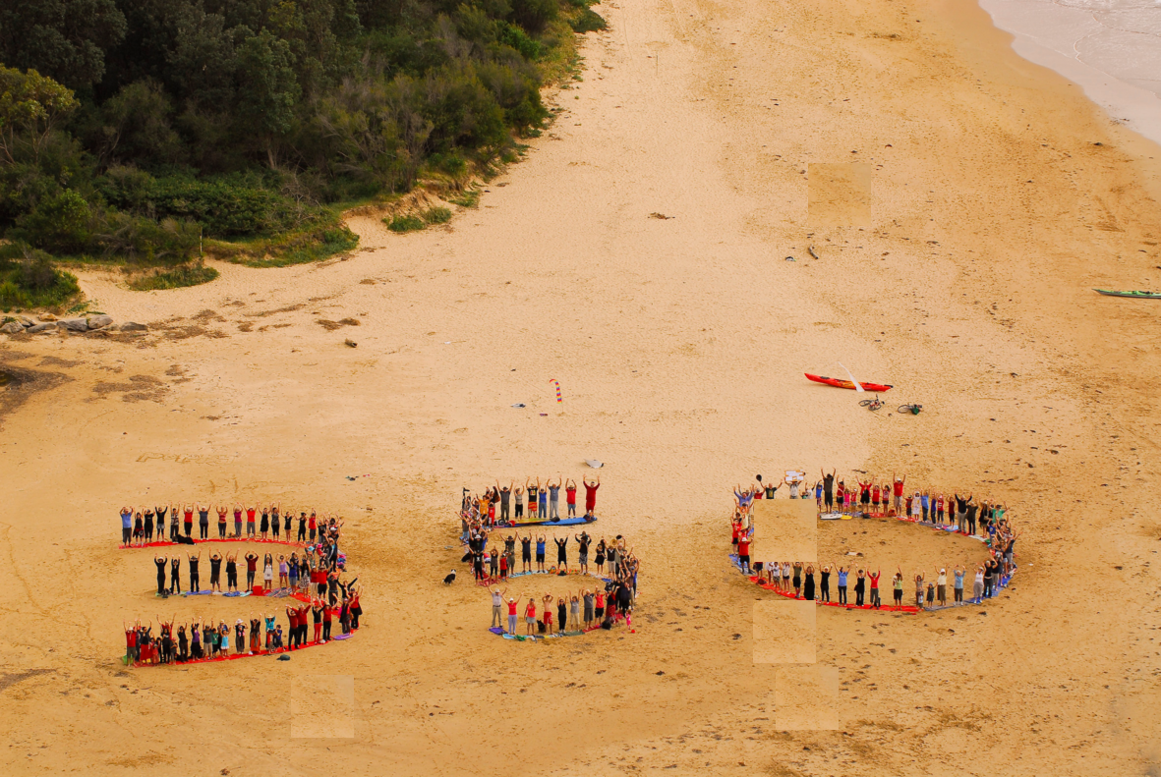

Examples of Multiple Forgery

Slide 23
Result
Our Result
Dataset | Precision | Recall | f1 Score
CMFDdb_grip | 98.17% | 98.15% | 97.62%
CVIP Group | 98.68% | 98.25% | 98.54%
Image Manipulation Dataset | 97.85% | 97.64% | 97.03%
MICC-F8 Multi | 98.84% | 98.54% | 97.93%
Comparison with Reviewed Literature
NO. | Dataset | Precision | Recall | f1 Score
Literature 2 | CMFDdb_grip | 95.9% | 94.2% | 96.05%
Literature 3 | CVIP Group | 87.68% | 87.25% | 87.54%

Slide 24
CONCLUSION
In this work, we present a digital forensic technique for detection of image forgery.
The proposed technique exploits the feature of double-compression, inherent in forged images.
The proposed technique enables forgery detection to single copy-move forgery as well as multi copy-move forgery.

Slide 25
FUTURE WORK
Automation of quality factor determination is a major future direction for this research.
Reconstruction of forged image regions will also be investigated in the future.

Slide 26
REFERENCE
H. Farid, “Exposing digital forgeries from JPEG ghosts,” IEEE Transactions on Information Forensics and Security, vol. 4, no. 1, pp. 154–160, Mar. 2009.
J. Wu, M.V. Kamath, S. Poehlman, "Detecting dierences between photographs and computer generated images", Proceedings of the 24th IASTED International conference on Signal Processing, Pattern Recognition, and Applications, pp 268273,2016.
H.T. Sencar and N. Memon, (eds.), "Digital Image Forensics: There is More to a
Picture than Meets the Eye", New York, NY, USA: Springer, 2013.
G. Wallace, “The JPEG still picture compression standard", IEEE Transactions on Consumer Electronics, vol. 34, no. 4, pp. 30-44, 1991.
D. Lowe, “Distinctive image features from scale-invariant key-points", International Journal of Computer Vision, vol. 60, no. 2, pp. 91-110, 2004.
A. Srivastava, A.B. Lee, E.P. Simoncelli and S.C. Zhu, “On advances in statistical modeling of natural images", Journal of Mathematical Imaging, vol. 18, no. 1, pp.17-33, 2003.
J. Redi, W. Taktak, and J.L. Dugelay, “Digital Image Forensics: A Booklet for Beginners", Multimedia Tools and Applications, vol. 51, no. 1, pp. 133 162, Jan. 2011.

Slide 27
THANK YOU
sandipan@parrotsec.org

